Slide 1

Leadership
Dr. Edward A. Merritt
The James A. Collins Distinguished Professor of Management
California State University (Cal Poly Pomona)
merritte@member.cmaa.org

Slide 2
Resources
Leading Clubs Effectively, Contemporary Club Management, 3rd Edition
Strategic Planning and Management, Contemporary Club Management, 3rd Edition
BMI

Slide 3
Definition of leadership
Inducing followers to accomplish certain goals that represent the values, wants and needs, aspirations and expectations of both leaders and their followers
Notes:
PRACTICE QUESTION
Leadership can be defined as
A) Motivational techniques primarily using threat intended to induce retention and commitment from followers
B) Coercing of followers to avoid punishment in achieving their goals and objectives
C) Being mostly effective when using centralized decision making and using organizational power to force others to achieve their goals and objectives
D) Inducing followers to accomplish certain goals that represent the values, wants and needs, aspirations and expectations of both leaders and their followers

Slide 4
Overview
Leadership is a social process
Crosses multiple disciplines
Open to a variety of meanings
Notes:
PRACTICE QUESTION
Leadership
Is a social process
Crosses multiple disciplines
Open to a variety of meanings
All of the answers are correct

Slide 5
Leadership theories
Armchair theories
The Grid model
The managerial grid
Situational leadership
Contingency theory
Details to come

Slide 6
Armchair theories
Also called personalized theories
  Based on personal experience
  Conjecture
  Personal feelings
Notes:
PRACTICE QUESTION
Armchair theories
Are sometimes referred to as personalized theories
Are based on personal experience
Are based on personal feelings
All of the answers are correct

Slide 7
Armchair theories
Great Man Theory (great person theory)
  Superhuman
  Attributes of hero
  Charisma, intelligence, willingness to sacrifice
  Examples
    John F. Kennedy, Mother Teresa

Slide 8
Armchair theories
Follower Theory
  Smart follower learns on the job and becomes a leader
  Importance on the experience of leader and ability to relate to the group
Example:
  Server >> Supervisor >> Food & beverage manager >> Assistant manager >> Clubhouse manager >> General manager
Notes:
Which leadership theory places primary importance on the leader’s experience and ability to relate to group members?
Follower theory (CMAA Leadership Chap.)
Great man theory
Genius theory
Democratic theory

Slide 9
Armchair theories
Genius Theory
  Becomes leader by special talent and or knowledge
  Separated from others because of talent or knowledge
  Leader by virtue of talent or knowledge
Examples
  Michael Jordan, Steven Jobs

Slide 10
Other theories

Slide 11
The grid model
Production (work)
System-Oriented behavioral on the Y axis
Behavior directed toward accomplish group goals
People (individuals)
Person-Oriented behavioral on the X axis
Action directed toward satisfying the needs and preference of individuals

Slide 12
The grid model
Person Oriented. The X-axis moves horizontally from left (low) to right (high) from 0-9
Systems Oriented. The Y-axis moves vertically from bottom (low) to top (high) from 0-9
 | 0X- | 1X- | 2X- | 3X- | 4X- | 5X- | 6X- | 7X- | 8X- | 9X-
9Y-
8Y-
7Y-
6Y-
5Y-
4Y-
3Y-
2Y-
1Y-
0Y-

Slide 13
Managerial grid
Blake & Moulton applied the existing Grid Model to develop another similar behavioral approach to leadership
Organized to identify the type of leader who would display
  high or low task behavior and
  high or low relationship behavior
Notes:
PRACTICE QUESTION
The managerial grid was organized to identify the type of leader who would display what types of behavior?
High task behavior
High relationship behavior
High or low task behavior and high or low relationship behavior
High task behavior and high relationship

Slide 14
Managerial grid
High relationship and task orientation
Y= RO v
 | (1,9) |  |  |  |  |  |  |  | (9,9)
 |  |  |  |  | (5,5)
 | (1,1) |  |  |  |  |  |  |  | (9,1)
(0,0) |  |  |  |  |  |  |  |  |  | X= TO >
RO = Relationship orientation
TO = Task orientation
High relationship, Low task orientation
High task, Low relationship orientation
Low relationship, Low task orientation
Adequate relationship and task orientation

Slide 15
Situational leadership
Hersey & Blanchard
Styles: Directing, Coaching, Supporting, Delegating
Club managers show overwhelming preference for low direction/high support
Changing style has a maturing effect on followers
Considers both leader and follower
Allows leaders to focus their attention where needed
Details to come
Notes:
Private club managers show an overwhelming preference for which type of leadership style?
High direction/low support
High direction/high support
Low direction/high support (CMAA Leadership Chap.)
Low direction/low support
The use of a situational leadership approach allows leaders to:
Successfully run their day-to-day organization
Focus their attention only on the best employees
Focus their attention where needed (CMAA Leadership Chap.)
Private club managers show an overwhelming preference for which type of leadership style?
High direction/low support
High direction/high support
Low direction/high support (CMAA Leadership Chap.)
Low direction/low support
Delegate important decisions to employees

Slide 16
Situational leadership
Less experienced followers need more direction
Fosters decision making via delegation
Information flows laterally and downward
Works with individuals and groups
Be aware that individuals mature at different rates when working in groups
Notes:
PRACTICE QUESTION
In situational leadership
Individuals mature at the same rates when working in groups
Information flows laterally and upward (downward)
Works with both individuals and groups
Fosters decision making via centralization

Slide 17
Situational leadership
Maturity level of follower/group | Appropriate leadership style
M1: Low maturity | Directing
M2: Medium maturity limited skill | Coaching
M3: Medium maturity higher skill | Supporting
M4: High maturity | Delegating
Notes:
According to Hersey and Blanchard’s situational leadership theory, if the maturity level of the group is judged to be high, the most appropriate leadership style is:
Directing
Coaching
Supporting
Delegating (CMAA Leadership Chap.)

Slide 18
The LPC contingency theory
Fielder’s Least Preferred Co-worker (LPC) theory based:
  Friendliness
  Task
Summary: Leader will work best/most with a liked follower and work worst/least with an unliked follower
Notes:
PRACTICE QUESTION
If summarizing the LPC contingency theory
Group members will work best/most with a liked team member
Group members will work worst/least with an unliked team member
A leader will work best/most with a liked follower
A leader will work worst/least with an unliked follower
Both C and D are correct
Both A and B are correct

Slide 19
Elements of leadership
Leadership vests in people
  People possess leadership characteristics
  Positions do not possess leadership characteristics
Power based to a great degree on follower willingness to be led

Slide 20
Types of power
Position Power
  Lead by organizational rank: CEO, GM, CFO
Personal Power
  Leaders use their personalities to help get cooperation from followers
Expert power
  If a someone has an expert skill, they can influence those with less skill in that area
Purpose Power
  Mission takes priority over personal desires
Notes:
PRACTICE QUESTION
In personal power
A person leads by organizational rank (such as GM)
Leaders use their personalities to help get cooperation from followers
Mission takes priority over personal desires
A person exercises power by threatening or taking away rewards

Slide 21
Types of power
Reward Power
  Influencing behavior by offer of a reward
Coercive Power
  Opposite of reward power
  Have the ability to take away or withhold rewards

Slide 22
Time Lag Concept
Likert
In relative terms a trial and error concept
Leader actions do not directly affect results
There is a time lag
Results occur over time
Notes:
PRACTICE QUESTION
In the time lag concept
Leader actions do not directly affect results
Results occur over time
There is a time lag
All of the answers are correct

Slide 23
Theory X
Average person dislikes work
Most people must be coerced, controlled, or directed
Average person prefers direction

Slide 24
Theory Y
Working is as natural as playing as long as it is satisfying
People exercise self-direction to goals if committed
Commitment is a function of rewards
Notes:
Practice Question
In Theory Y
Commitment is a function of rewards
Most people must be coerced, controlled, or directed
Upward mobility occurs via skill specialization
Current trends in management are moving toward Theory Y style

Slide 25
Theory Z
Implies trust in the judgment of people
Upward mobility via skill specialization
Current trends in mgmt moving toward Theory Z style
Notes:
Which theory implies trust in the judgment of people?
Theory W
Theory X
Theory Y
Theory Z (CMAA Leadership Chap.)

Slide 26
Evaluation of leader effectiveness
3 criteria for judging:
  Group satisfaction
  Group productivity
  Group performance
Leader can delegate
  Authority
  Power
  Decision-making
Leader cannot truly delegate responsibility to an employee
Notes:
Which cannot be delegated to an employee?
Authority
Power
Decision-making
Responsibility (Management Delegation – Rue, BMI)

Slide 27
Leadership skill
There is a difference in executing a skill well and being an effective leader, one must execute well over the long run
Shared vision helps build employee commitment to the long term
Common pitfall of inexperienced leaders is micro-managing employees
Notes:
Which is a common pitfall of inexperienced leaders?
Developing new communication channels
Micro-managing employees (CMAA Leadership Chap.)
Using a delegation style of leadership
Ensuring that all information flows horizontally
What helps build employee commitment to the long term?
Shared vision (CMAA Leadership Chap.)
A sense of crisis
The work done by specific employees
Cheering the results not the progress

Slide 28
Motivational theories

Slide 29
Motivation
Definition:
  A force to perform
Two Factors:
Intrinsic: One’s perception of self
  Satisfaction in completing a task
Extrinsic: One’s perception of the external world
  Money, coercion, or threat of punishment

Slide 30
Motivation Examples
  Achievement
  Affiliation with others
  Competence
  Power
  Attitude
  Incentive
  Fear

Slide 31
Motivation Theories
Expectancy Theory
  Path-Goal Theory
Maslow’s Hierarchy of Needs
Herzberg’s Maintenance Factor Theory
Details to come

Slide 32
Expectancy theory
Assumptions
  People anticipate or expect that things will occur
  People confront possible alternative behavior and rational ways
  Through experience, people learn to anticipate the likely consequences and learn alternative behaviors

Slide 33
Path-Goal Theory
Is a type of Expectancy Theory
An individual is motivated by understanding the amount of energy (drive) needed to achieve an outcome
Motivation exists if the path has been cleared of obstacles
Leader then becomes a facilitator, removing obstacles from the path
Notes:
PRACTICE QUESTION

Slide 34
Maslow’s hierarchy
Assumptions
  A need that has already been satisfied is no longer a motivational factor
  The needs of an individual are complex
  One will tend to be motivated toward higher order needs

Slide 35
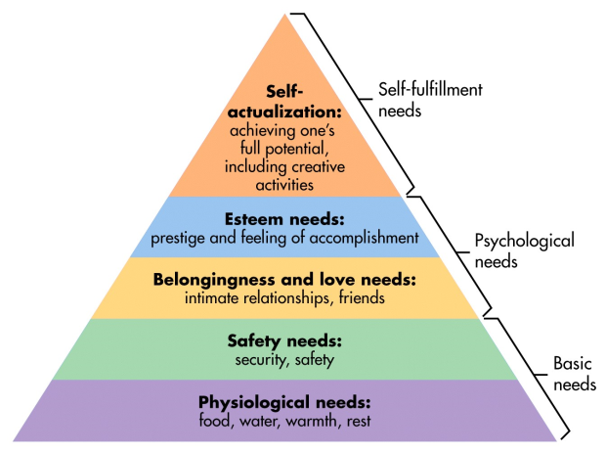
Maslow’s hierarchy

Slide 36
Herzberg’s two-factor theory
Factors
  Motivational (relates to intrinsic)
  Maintenance (relates to extrinsic)
Leader’s responsibilities
  Examine work environment
  Determine dissatisfaction
  Eliminate dissatisfaction
  Details to come
Notes:
PRACTICE QUESTION
Applying Herzberg’s two-factor theory
A) Motivational factors relate to intrinsic elements
B) Maintenance factors relate to extrinsic elements
C) Motivational factors relate to extrinsic elements
D) Maintenance factors relate to intrinsic elements
E) Both A and B are correct
F) Both C and D are correct

Slide 37
Herzberg’s Motivation Factors
Motivating Factors
Achievement
Growth Potential
Responsibility
Advancement
Recognition
Status
Intrinsic

Slide 38
Herzberg’s maintenance factors
Maintenance
Factors
Working Relationships
Salaries
Interpersonal Relations
Benefits
Environmental Climate
Job Security
Extrinsic

Slide 39
Construct for effectiveness
Create and establish goals
Reports both oral and written should quantify results in objective measures, how measurement relates to goals and objectives, and to the dept and club strategic plan
An example of an important leadership ability is persuading others to contribute to the club’s effectiveness
Notes:
Which is an example of an important leadership ability?
Attempting to maintain the status quo
Persuading others to contribute to the club’s effectiveness (CMAA Leadership Chap.)
Doing things efficiently
Possessing operational skills in food and beverage management

Slide 40
Evaluate progress
Employee
Performance reviews
Informal review weekly or monthly
Formal at least semi annually
Club or department
Measure operating results vs budgets
  Monthly variance meetings
  Quarterlies
Goal achievement
Compare to survey

Slide 41
Reward
Incentive bonuses for managers
Smaller incentive bonuses, preferred scheduling, etc. for non-management
Use objective measures that all employees can understand and track

Slide 42
Time management
Break bad habits
Learn to delegate
Eliminate interruptions
Details to come

Slide 43
Improving time mgmt skills
Procrastination
  Human failing most closely associated with poor time management
No closure
Ineffective communication
Inability to say no
Time leaks (too much attention to low-yield projects)
Notes:
What human failing is most closely associated with poor time management?
Ineffective communication
Inability to say “no”
Procrastination (CMAA Leadership Chap.)
Lack of interest

Slide 44
Delegating to others
Investigate and report back to me
Recommend an action
Advise of action planned
Take action and advise action taken
A leader cannot truly delegate full responsibility

Slide 45
Team phases
1 Forming
2 Storming
3 Norming
4 Performing
5 Transforming

Slide 46
Forming
Become acquainted
Display positive outlook
Test and feel their way along
Seek to understand the mission

Slide 47
Storming
Subgroup hostility
No group structure
Cliques & coalitions
Team dynamics vs. Accomplishment
Interaction emerges

Slide 48
Norming
Rules of conduct established
Policies set; goals agreed upon
Peer culture positive
Team cohesive, working together
Notes:
PRACTICE QUESTION
In which phase of teams are the rules of conduct established, policies set, goals agreed upon, and the team is working together?
Forming
Storming
Norming
Performing

Slide 49
Performing
Develops over time
Solutions emerge
Members carry out their work interdependently

Slide 50
Transforming
Ad hoc
  Dissolution
On-going
  Losing many key group members
  Must go back minimum one level and re-group

Slide 51
Personal leadership
Managers should do their most difficult jobs, if these jobs can be scheduled, during their peak energy period
Steps in effective delegation
  Think the project through
  Select an employee
  Meet with the employee
  Set a deadline
Notes:
When should managers do their most difficult jobs if these jobs can be scheduled?
At the beginning of the day
Spread out throughout the day
During their peak energy period (Time Management – Rue, BMI)
The first step in effective delegation is to:
Think the project through
Set a deadline
Select an employee
Meet with the employee
At the end of the day

Slide 52
Strategy

Slide 53
Long-term process
In the strategic management system, the strategic planning process involves the longest term decision making
Operational planning typically focuses on upcoming 12 month timeframes
Strategic planning typically focuses on timeframes beyond 12 months
Notes:
Which component of a strategic management system involves the longest-term decision-making?
Tactical planning
Operational planning
SWOT analysis
Strategic planning process (CCM Exam Review-Leadership and Mgmt. – Debby)
Operational planning typically focuses on ________ months.
3 to 6
6
12
24

Slide 54
Decision-making models
Models available:
  Consensus
  Authority
  Majority
  Minority
  Unanimity
Of the decision-making models, consensus is the most effective for strategic planning
Notes:
Practice Question
Which decision-making model is most effective for strategic planning?
Decision by vote
Decision by veto
Decision by leader
Decision by consensus

Slide 55

Strategic planning
Dynamic environment - flexible
Strategic versus tactical times
Rolling & continuous

Slide 56
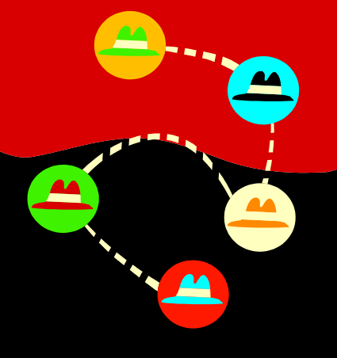
The strategic process
1. Determine need
2. Get member input
3. Know the competition
4. Hold a board retreat
5. Develop a plan
6. Implement the plan
7. Dominate niche

Slide 57

1. Needs Assessment
Confidential interviews
Review minutes
Review financials
Operational audit
Identify issues
Environmental scan
  Determine and compare info about clubs in your club’s competitive set
Notes:
When developing a club’s strategic plan, an environmental scan should be undertaken for what purpose?
To review ecological concerns that should be incorporated into the plan
To determine and compare information about clubs that are in the club’s competitive set (CMAA Strategic Chap.)
Determine any future federal, state, and/or local regulations and legislation that will impact the club
Determine what concerns should be addressed by the club’s strategic plan
PRACTICE QUESTION
An environmental scan should be undertaken during which step of the strategic process? 57
A) 1. The Needs Assessment
B) 3. The Competitive Analysis
C) 4. The Retreat
D) 5. The Plan Development

Slide 58

2. Membership Input
Focus Groups
Benchmark Survey Results
Identify Competition
Membership Survey
  Use performance and importance scales on operations questions to determine
    “How are we doing?”
    “Are we doing the right things?”

Slide 59

Example scales
Wednesday night a la Carte dinner
Performance A A- B+ B B- C+ C C- D+ D
Importance 10 9 8 7 6 5 4 3 2 1
Detail points:
Performance scale (how are we doing?) uses a report card style range
Importance scale (are we doing the right things?) uses a 10 (best) to 1 (worst) scale
Ratings are from high to low
Each scale has same number of ratings

Slide 60
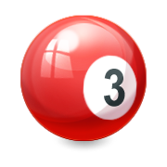
3. Competitive Analysis
Identify Competition
Conduct Survey
Identify Benchmarks (from survey)
  Golf Maint: Greens must Stemp at 10
  Front Desk: 3 phone rings is one too many
  Mixed grill: 30 secs is max wait at the lectern
  Golf: 4 hrs max golf rounds
  Details to come

Slide 61

4. Retreat
Ideally away from the club
10-15 attendees
Create structure for continuity
Develop or confirm values, vision, mission, and key goals and objectives
Consider using a facilitator
Notes:
PRACTICE QUESTION
During which step of the strategic process are values, vision, mission, and key goals and objectives confirmed? 61
A) 1. The Needs Assessment
B) 3. The Competitive Analysis
C) 4. The Retreat
D) 5. The Plan Development

Slide 62
The Model
Action – Front Line
Mission, Vision, and Values – GM and Board
Operations Strategy – Supervisors
Goals & Objectives – Dept Heads
Structure
Foundation

Slide 63
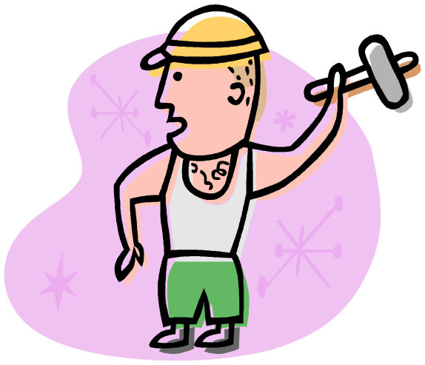
Values & beliefs
What the club is all about
Bedrocks
Fundamental convictions
Strong statements
Ideally will have buy-off
Explains why the club exists
High level (helicopter view)

Slide 64

Values & beliefs examples
Member satisfaction (survey)
Employee satisfaction (survey)
Financial stability (budget)
Ethical business practices
Service to the community
Understand that member satisfaction (measured by the survey across time) and financial stability (measured by budget across time) are the two vital club report cards

Slide 65

Vision
Where you want the Club to be positioned
A bold statement that paints a picture of what the club will look like
Trend toward combining vision with mission

Slide 66
Vision example
By the year 2020, the Cassiopia Golf Club will be a premier golf club with a memorable and top-conditioned course
It will reach a full membership of 350 regular members and a waiting list to join
Achieve gross revenues of $10 million annually, with a capital reserve of $2 million
The Club will offer superior food & bev service, exceeding club member expectations
The Golf Club will be the employer of choice in the Greater L.A. area

Slide 67

Mission
The reason for the club’s being
A broad statement of the fundamental purpose for which the club exists
Values drive mission
SWOT occurs at this stage
Notes:
A broad description of a club’s fundamental purpose is found in its:
Values statement
Mission statement
Vision statement
Key result areas
What is true about values?
They drive visions
They drive missions (Cichy Teams, BMI)
They serve as goals
They serve as objectives

Slide 68

Mission SWOT
Strengths (Internal)
Items which contribute to success
Assume excess cash on hand
Consider with External opportunities
Weaknesses (Internal)
Items which limit success
Ingress and egress to upper and lower clubs
Consider with External Threats

Slide 69

Mission SWOT
Opportunities (External)
Items from the outside which could contribute to success
Developer club is going under
Threats (External)
Items from the outside which could limit success
DUI laws
Notes:
The “T” in “SWOT” applies to:
Tactics
Training
Threats
Techniques

Slide 70
Mission statement
Define: A broad description of a club’s fundamental purpose
States why the team exists and how it contributes to the overall goals of an organization
Objectives are statements that outline what an organization is trying to achieve while giving it direction and purpose
Middle management develops departmental objectives and policies for achieving organizational objectives
Notes:
A broad description of a club’s fundamental purpose is found in its:
Values statement
Mission statement
Vision statement
Key result areas
A broad description of a club’s fundamental purpose is found in its:
Values statement
Mission statement
Vision statement
Key result areas
Which level of management develops departmental objectives and policies for achieving organizational objectives?
Middle management
Supervisory management
Operative management
Senior management

Slide 71

Mission statement example
Given that the golf experience is its highest priority, Cassiopia Golf Club is committed to providing superior golf, casual dining, and seasonal social experiences for the satisfaction of its members and their families

Slide 72
Publicize mission
Once established publish and publicize
  Prospective member materials
  New member welcome packages
  Committee orientation
  Board orientation
  Officer orientation
  Newsletter masthead
  Stationery
  Business cards
  Web pages
  Employee orientation
  Employee training
  Business cards

Slide 73

5. Plan development
Tenets agreed by Board
Usual format:
  Prioritized list of initiatives with timelines
  Operations budget (annual)
  Capital expense / FF&E budget (annual)
  Project capital (annual and forecast)
  Economic model (Slide)
Usually does not come together sequentially
Plan drafted by management and staff
Final adopted by Board

Slide 74
Strategy statement
Enhancing differentiation
  Addresses club strengths
Enhancing superiority
  Exploit competitor’s weaknesses
Innovating
  Develop new products or services
Revolution
  Drastic measures required
Notes:
When a club uses an enhancing differentiation strategy, it is attempting to address its:
Strengths (CMAA Strategic Chap.)
Weaknesses
Opportunities
Threats

Slide 75


Goals & objectives
SMART goals
Specific
Measurable
Acceptable
Realistic
Timely
Align with strategy
By department
Line by line
Written assumptions
Seasonalized
Sample calculation
Understood by generalist
Use as basis for variance review
Notes:
Putti

Slide 76

Operations strategies
How do you want to get there?
What should we invest in to achieve our objective?
Broadly stated
What we want people working
toward
Usual time period is 12 months
Carried out by staff

Slide 77

6. Implementation
The action
Almost always achieved by paid staff
Terms used:
  Implementation
  Operationalization
  Operations

Slide 78

7. Consistently dominate niche
Resist becoming a Frankenstein Club
Economy:
Best Western
Days Inn
1, 2, 3
Upper-Level:
Marriott
Hilton
7, 8
Ford Escort Club
Toyota Camry Club
1 | 2 | 3 | 4 | 5 | 6 | 7 | 8 | 9 | 10
Mid-Level:
Holiday Inn
Comfort Inn
4, 5, 6
Luxury:
Ritz-Carlton
Four Seasons
9, 10
Honda Civic Club
BMW 760IL Club

